Slide 1


Spatial Navigation
Data
Kay Otsubo
Priscilla Fung
Prateek Dhamija
Notes:
- Add slide of trials

Slide 2
Introduction
Question: Are participants more likely to remember items that are congruent with their environment?
Natural Resources (food/water) in a Rural Environment
Artifacts (money) in an Urban Environment
Hypothesis: There will be a greater memory (Bhattacharyya coefficient) for items that are congruent with their environment

Slide 3
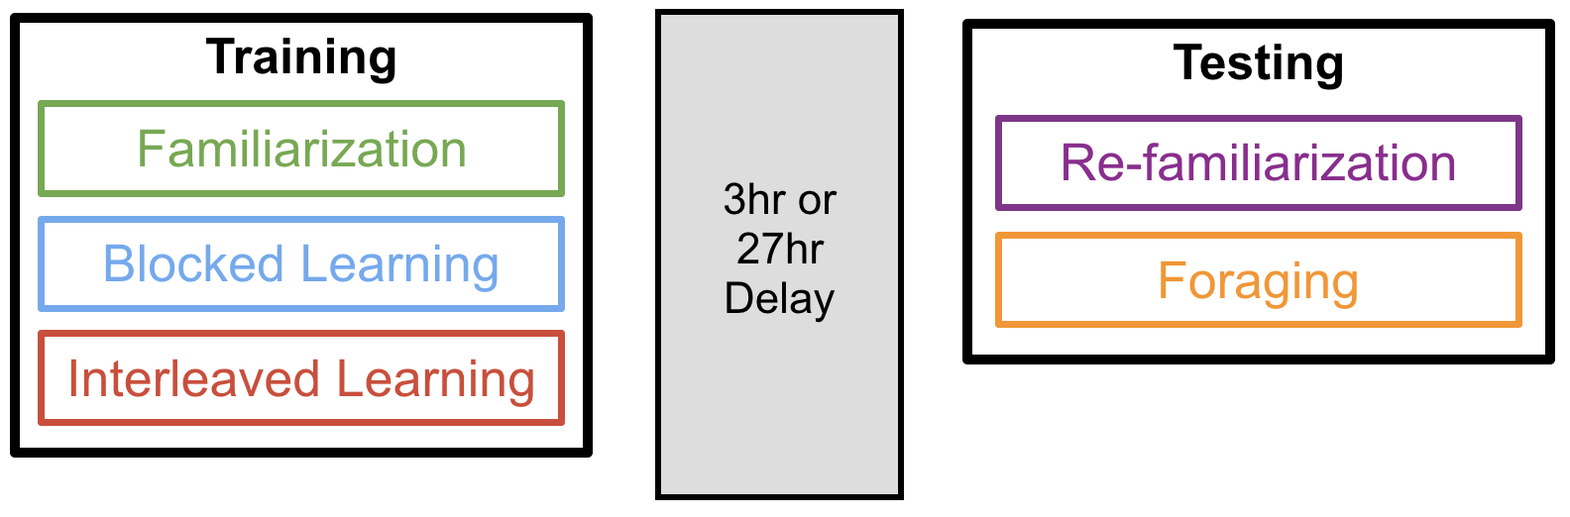
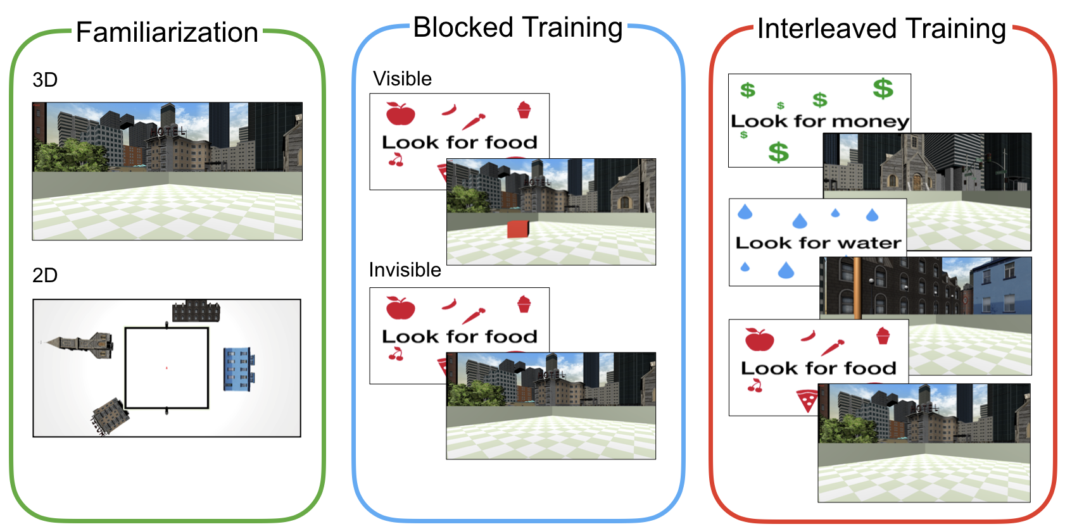
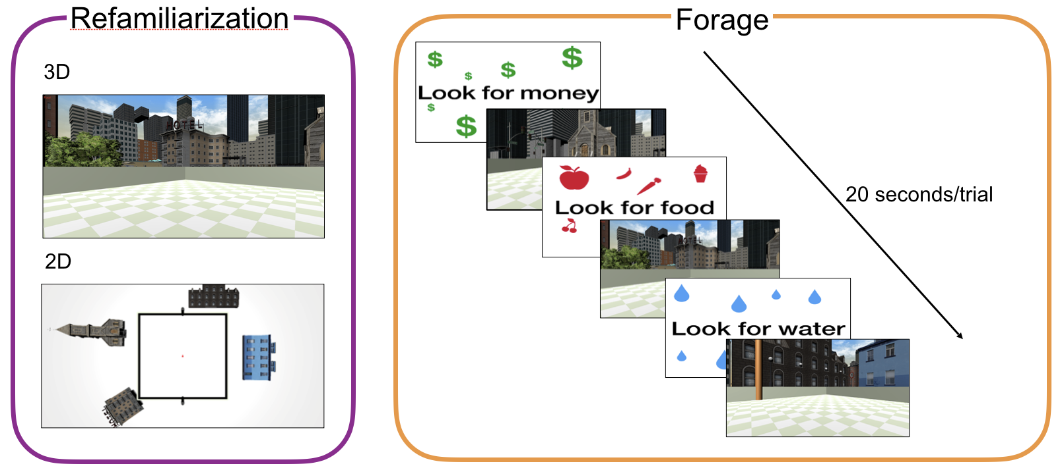
Task Procedure
1
2
3
1
4
Test
1. During Familiarization and refamiliarization participants explore the environment freely, they are asked periodically to identify their position on an allocentric map.
2: Blocked training occurs for each reward item. Participants complete several visible trials, then several invisible trials.
Each trial the participant is cued with the reward item the are to look for then placed into the environment and instructed
To find it
3: Interleaved training is completely randomized and 90% of rewards are invisible. There is a one visible trial for each reward type that occurs in within the first 13 trials of the interleaved block, Participants are cued with a
4: During test participants are cued with random rewards and have 20 seconds on each trial to find them. They aren’t given any feedback whether they found the reward or not.
Notes:
Procedure
In this 2-by-2 between subject design, each participant was assigned to one of two delay conditions: long (27hr) or short (3hr), and to one of two environmental conditions: Environment 1 or Environment 2 (n=11 per condition combination). The experiment consisted of a Training and a Test Session. During the training session, participants learned the locations of three goal types (i.e. food, water, money) by finding visible and hidden objects. Goal objects were placed within a 2-dimensional Gaussian distributions corresponding to the goal type. The centre of each goal distribution was placed in polar coordinates (r = 7.5m) with equal rotational distance (120 degrees) separating each distribution and a standard deviation of 2 metres (Fig. 1C).
Session 1: Training: The encoding session consisted of 3 blocks: Familiarization, Blocked Learning, and Interleaved Learning.
Block 1 – Familiarization: During each of 8 familiarization trials participants were placed into their assigned environment at a random location and their viewpoint was rotated 360 degrees. Once the rotation was complete, participants were instructed to move freely around the environment for 10 seconds. Participants were then shown a bird’s eye view of the environment and asked to move an arrow from the centre of the arena to their last location and then press spacebar. The next trial would then begin.
Block 2 –Blocked Training: were trained on the locations of three goals: Food, Water and Money. Goals were always trained in the same order (Food, Water, Money) beginning with 12 visible learning trials followed by 15 invisible trials.
Visible Training Trials: Participants were first cued with a screen indicating their current goal and then placed into the environment. As in the familiarization block, participants were placed at a random location and their view was rotated 360 degrees. Each trial included one visible goal object: a coloured 3D cube (Food = red, Water = blue, Money = green), positioned according to its corresponding goal distribution. Participants were instructed to collect the object as quickly as possible and given 10 seconds to do so. Upon collecting the object, the participant heard a sound associated with the goal type and the next trial began. If the object was not collected in time, the trial ended and the next trial began. On every other trial, participants were asked to locate where they had found the object on a bird’s eye map, like in the familiarization phase.
Invisible Training Trials: This block was identical to the Visible Training block with the following exceptions: (1) goal-objects were invisible and participants were instructed to find them using their , and (2) they were given 15 seconds to complete a trial.
Block 3 - Interleaved Training: Interleaved Training began after completing Blocked Training for each of the three goals. Participants were cued with one of the three goals, placed into the environment, and given 15 seconds to find it. All goal objects were invisible with the exception of one visible trial per goal which occurred within the first 10 trials of the block. Goal order was determined pseudorandomly with 12 trials for each goal type.
Session 2: Testing: The Testing session consisted of a Refamiliarization and a Foraging Block.
Block 1 - Refamiliarization: The Refamiliarization lock procedure was identical to the familiarization block during encoding.
Block 2 – Foraging: Participants were told that a large number of objects were hidden on each trial and that their job was to find as many as possible in 20 seconds using what they learned in the first session. The relevant type (food, water, money) was cued at the beginning of each trial, then participants were placed at a random arena location. Goal order was pseudorandomized with 26 trials per goal. No feedback was given.

Slide 4
Method
Pre-Cleaned Data
2 x 3 ANOVA
Figures
Follow-up Data Cleaning
Created a Summary Dataframe
Removed
P28
Calculated Bhattacharyya Coefficient
Notes:
Bhattacharyya Coefficient = Measure of overlapping search distributions (acquisition and memory)

Slide 5
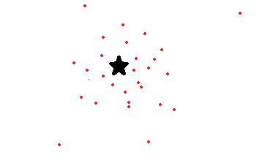
Battacharya Coefficient
Measure of overlapping distributions
Reward

Slide 6
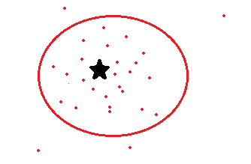
Battacharya Coefficient
Measure of overlapping distributions

Slide 7
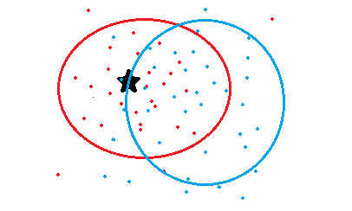
Battacharya Coefficient
Measure of overlapping distributions

Slide 8
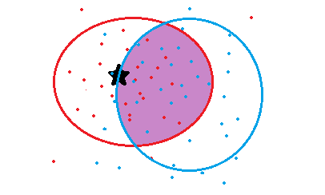
Battacharya Coefficient
Measure of overlapping distributions
Battacharya Coefficient

Slide 10


Results
Interaction: $F(2,129) = .06, p=.94$
Main Effect: $F\left(1,129\right)=4.81, p=.03$
Notes:
This is the interaction. The main effect of environment was significant.

Slide 11
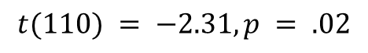
Results
*
$$t(110) = −2.31, p = .02$$

Slide 12

Conclusion
Item-Environment congruency has no impact on learning
Participants tend to do better in urban environment
This could be due to all participants living in urban environments
Money is required for food and water
Notes:
- urban environments may be easy for us to navigate where we are able to identify the differences amongst the buildings where we may not be as used to rural differentiations
Future studies:

Slide 13
Thank you for listening!

